Slide 1


Encoder Resolution
$R_{h}$ = Quadrature encoder resolution $\frac{counts}{rev}$
$T_{s}$ = Sample time (s)
$T_{f}$ = Sample frequency (Hz) = $\frac{1}{T_{s}}$
Change in angular position during one control loop
$$∆θ={(Count}_{now}−{Count}_{last})\frac{360\frac{deg}{rev}}{R_{h}\frac{counts}{rev}}$$
Angular velocity during one control loop
$$ω=\frac{∆θ}{T_{s}}=∆EncCount\frac{360}{R_{h}}T_{f}$$
At minimum operating speed, $∆EncCount$ must be at least 5 to add factor of safety, to avoid $∆EncCount$ = 0, which causes zero velocity error.
At fixed angular velocity and sample frequency, $R_{h}$ and $∆EncCount$ are proportionally related.
if $R_{h}$ is halved, $∆EncCount$ is halved
So, angular velocity resolution depends solely on sample frequency.
Smaller sample frequency (slower speed), improves angular velocity resolution.

Slide 2


Sample Calculations
Halve Quad Encoder Resolution at same angular velocity
$R_{h}$ = Quadrature encoder resolution = $4096\frac{counts}{rev}$
$T_{s}$ = Sample time (s)
$T_{f}$ = Sample frequency (Hz) = $\frac{1}{T_{s}}$ = 1000 Hz
$∆EncCount$ = 2.5 (impossible, must be integer)
$$ω=\frac{∆θ}{T_{s}}=∆EncCount\frac{360}{R_{h}}T_{f}$$
$$ω=2.5\frac{360}{4096}1000=219.7\frac{deg}{s}$$
I$f ∆EncCount$ = 3
$$ω=3\frac{360}{4096}1000=263.7\frac{deg}{s}$$
But velocity resolution is determined by whole integer $∆EncCount$, so resolution not comparable
$R_{h}$ = Quadrature encoder resolution = 8192 $\frac{counts}{rev}$
$T_{s}$ = Sample time (s)
$T_{f}$ = Sample frequency (Hz) = $\frac{1}{T_{s}}$ = 1000 Hz
$∆EncCount$ = 5
$$ω=\frac{∆θ}{T_{s}}=∆EncCount\frac{360}{R_{h}}T_{f}$$
$$ω=5\frac{360}{8192}1000=219.7 \frac{deg}{s}$$
If $∆EncCount$ = 6 (min change possible = 1 int)
$$ω=6\frac{360}{8192}1000=263.7 \frac{deg}{s}$$
So, velocity resolution = $\left(263.7−219.7\right)=43.9 \frac{deg}{s}$

Slide 3


Sample Calculations
Halve Sample Frequency at same angular velocity
$R_{h}$ = Quadrature encoder resolution = $8192\frac{counts}{rev}$
$T_{s}$ = Sample time (s)
$T_{f}$ = Sample frequency (Hz) = $\frac{1}{T_{s}}$ = 500 Hz
$∆EncCount$ = 5
$$ω=\frac{∆θ}{T_{s}}=∆EncCount\frac{360}{R_{h}}T_{f}$$
$$ω=5\frac{360}{8192}500=109.9 \frac{deg}{s}$$
If $∆EncCount$ = 6
$$ω=6\frac{360}{8192}500=131.8 \frac{deg}{s}$$
So, velocity resolution = $\left(131.8−109.9\right)=21.9 \frac{deg}{s}$
$R_{h}$ = Quadrature encoder resolution = 8192 $\frac{counts}{rev}$
$T_{s}$ = Sample time (s)
$T_{f}$ = Sample frequency (Hz) = $\frac{1}{T_{s}}$ = 1000 Hz
$∆EncCount$ = 5
$$ω=\frac{∆θ}{T_{s}}=∆EncCount\frac{360}{R_{h}}T_{f}$$
$$ω=5\frac{360}{8192}1000=219.7 \frac{deg}{s}$$
If $∆EncCount$ = 6
$$ω=6\frac{360}{8192}1000=263.7 \frac{deg}{s}$$
So, velocity resolution = $\left(263.7−219.7\right)=43.9 \frac{deg}{s}$

Slide 4
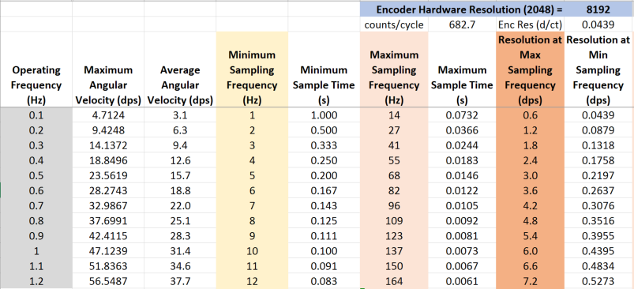
Tabulated Calculations

Slide 5
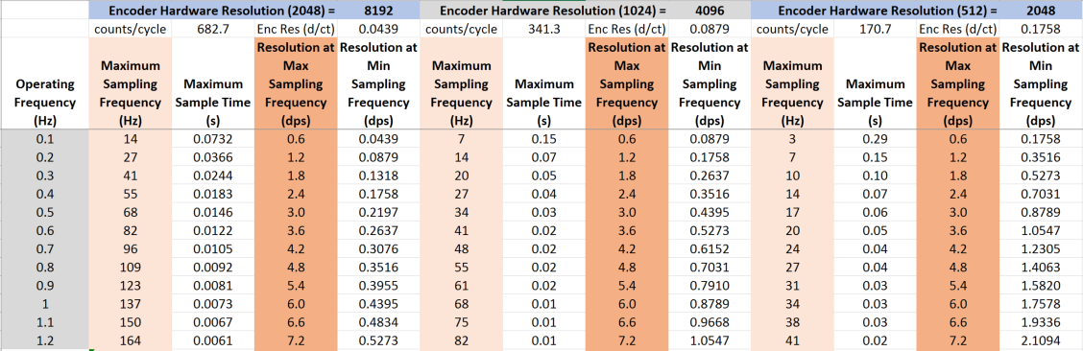
Conclusion (1/2)
Velocity resolution at maximum sampling frequency is the same, regardless of encoder hardware resolution
Decreasing hardware resolution decreases the maximum sampling frequency proportionally, so the highest hardware resolution results in the highest possible sampling frequency

Slide 6
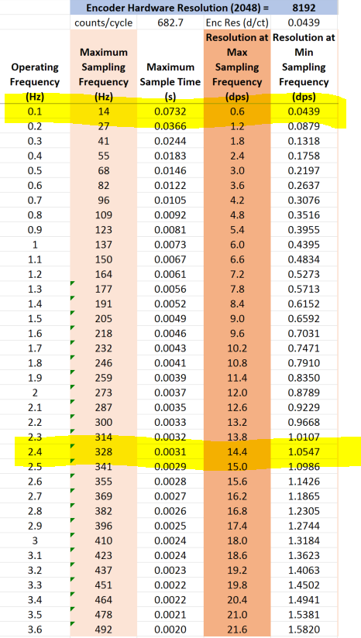
Conclusion (2/2)
If encoder is attached after linkages, and directly to platform shafts (no mechanical advantage = very slow shaft speeds for encoder), maximum sampling frequency depends on minimum operating frequency. If 0.1Hz is minimum operating speed, max sampling frequency with FS = 5 is approximately 14 Hz with 0.6dps resolution.
If encoder is attached before linkages (and assuming 3x mechanical advantage = faster shaft speeds for encoder), max sampling frequency with FS = 5 is approximately 328 Hz with 14.4dps resolution
Validated these results experimentally with less than 2% error.

Slide 7
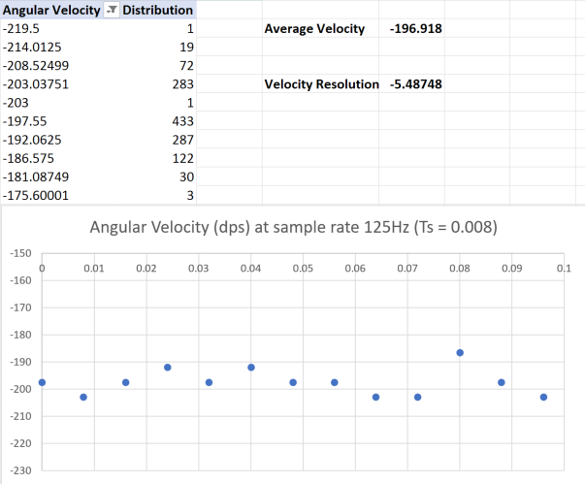
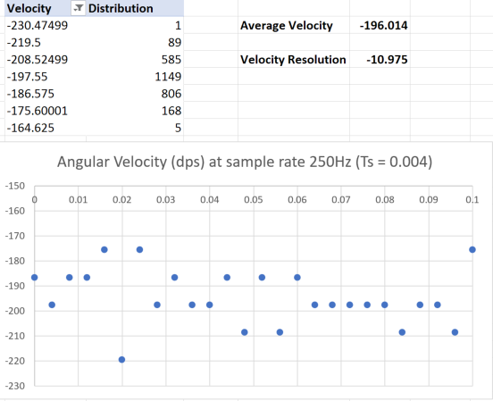
Backup – Velocity Resolution Validation

Slide 8
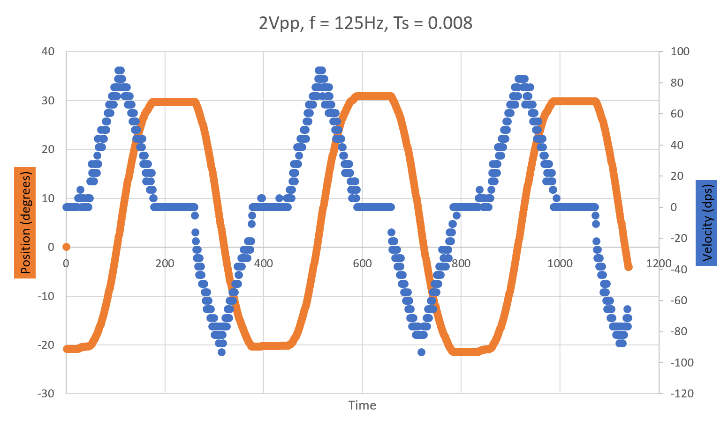
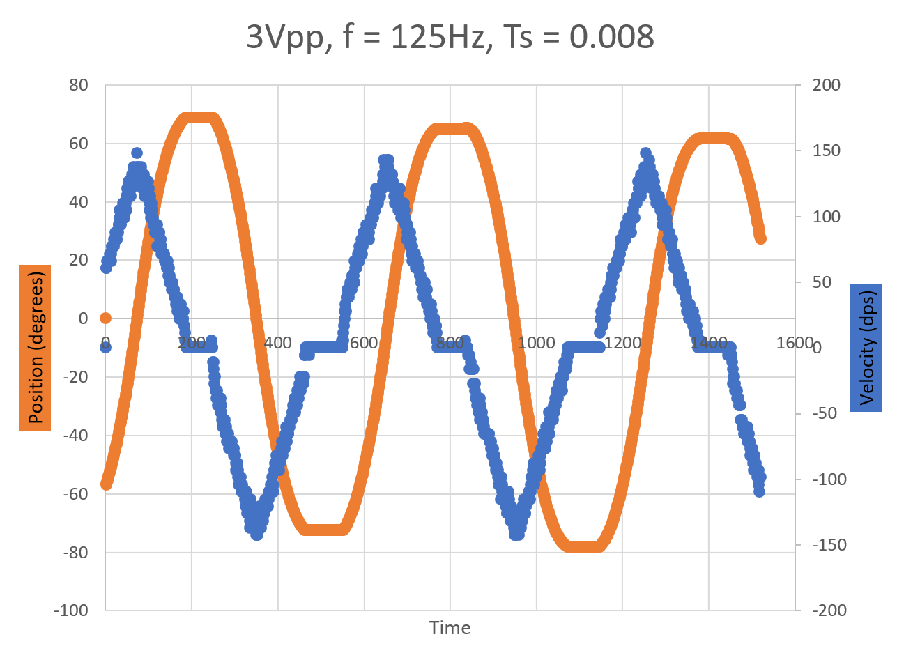
Backup – Sample Position/Velocity Curves

